Slide 1

Project on: Chess Engine with AI By: Radhey Sharma Reg. No.: 219311078 Mentor: Mr. Vinod Kumar

Slide 2
Introduction:
This project aims to make a program that allows a user to play chess against an AI that uses an algorithm to make pseudo-random moves.
Programming Language used: C

Slide 3
Motivation:
I was inspired to take on this project because I enjoy playing chess and wanted to make a program that can play chess. This project enables me to develop a better understanding of programming.

Slide 4
Objectives:
There are three main objectives of this project:
Create a chessboard with chess pieces.
Add movement constraints and rules of the chess game.
Create an AI that uses a Mini-Max algorithm to make moves.

Slide 5
Block Diagram:
Initial positions
The game ends when either of the two players manage to checkmate the other or in a draw or if the player quits.
Check which side is starting
If computer is starting
If player is starting
If player’s move is legal
Computer’s turn
Yes
Player moves
No
Player’s Turn
Computes a couple of moves ahead
Finds “best” possible legal moves and performs it

Slide 6
Methodology:
To create the chessboard, I will use a 2D Array.
Its rows will be numbered 1 to 8 from bottom to top and its columns will be numbered 1 to 8 from left to right.
Chess pieces will simply be the different values assigned to elements of the matrix.

Slide 7
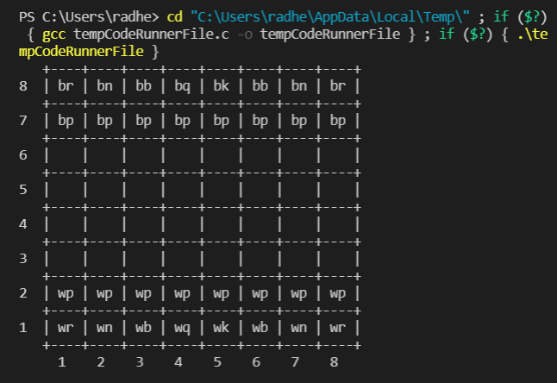
Values of the chess pieces in this program are as follows:
W King =10000 B King =10001
W Queen =900 B Queen =901
W Rook =500 B Rook =501
W Bishop =310 B Bishop =311
W Knight =300 B Knight =301
W Pawn =100 B Pawn =101

Slide 8
Move Generator:
The moves that the computer will make will be calculated by a Mini-Max algorithm.
In this program, the algorithm will find the move that gives the computer the highest possible score against the player's highest possible score. The score will be a function of the values of the chess pieces.

Slide 9
Time Graph:
Results
Working
Research
Introduction
Week 1 Week 2 Week 3 Week 4 Week 5 Week 6 Week 7 Week 8 Week 9

Slide 10
Thank You!
The Wikipedia article for Mini-Max Algorithm helped me with the basic understanding of the decision theory.
https://en.wikipedia.org/wiki/Minimax

